Slide 1
Image Editing Software and OpenCV
CSCI 4150/6050: Computer Vision

Slide 2
Midterm Preparation

Slide 3
Let’s appreciate how much of photoshop you could implement!

Slide 4
Let’s talk through a few more specific details…

Slide 5
Photographer vs. Class Terminology
A lot of tools in programs like Photoshop use photographer terminology, but a lot of these are implemented with operations we have already covered in this class.
  Example: Dodge/Burn = Increasing/Decreasing Brightness
Additionally, many tools are built to operate on a small region instead of the whole image.

Slide 6
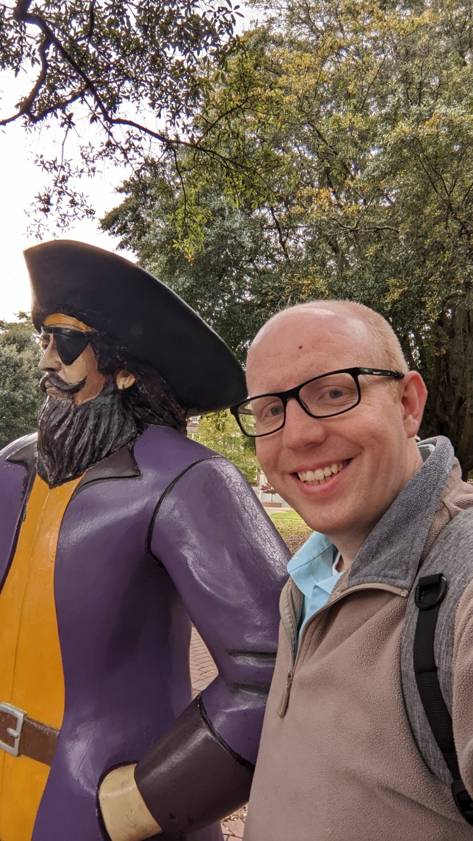
Class Demo: Touching Up a Photo

Slide 7
Non-destructive Editing
For photo editing, it important to have control of operations during the entirety of the editing process until the final image is rendered.
This is achieved through two main mechanisms:
  Operation Stack – Rather than performing operations in place, the set of all operations applied to image are placed in a stack, and the image is rerendered after every edit. Undo/redo simply becomes pop/push onto the stack.
  Layering System - All image data and adjustments can be stored in layers with corresponding masks.

Slide 8
Layering Systems
Image Layers store any imported image data, along with information about how to blend that image into the following layer.
  In other words, image data + mask + blend mode + opacity
Adjustment Layers indicate an operation that should be applied to all following layers, such as brightness increases or color changes.

Slide 9
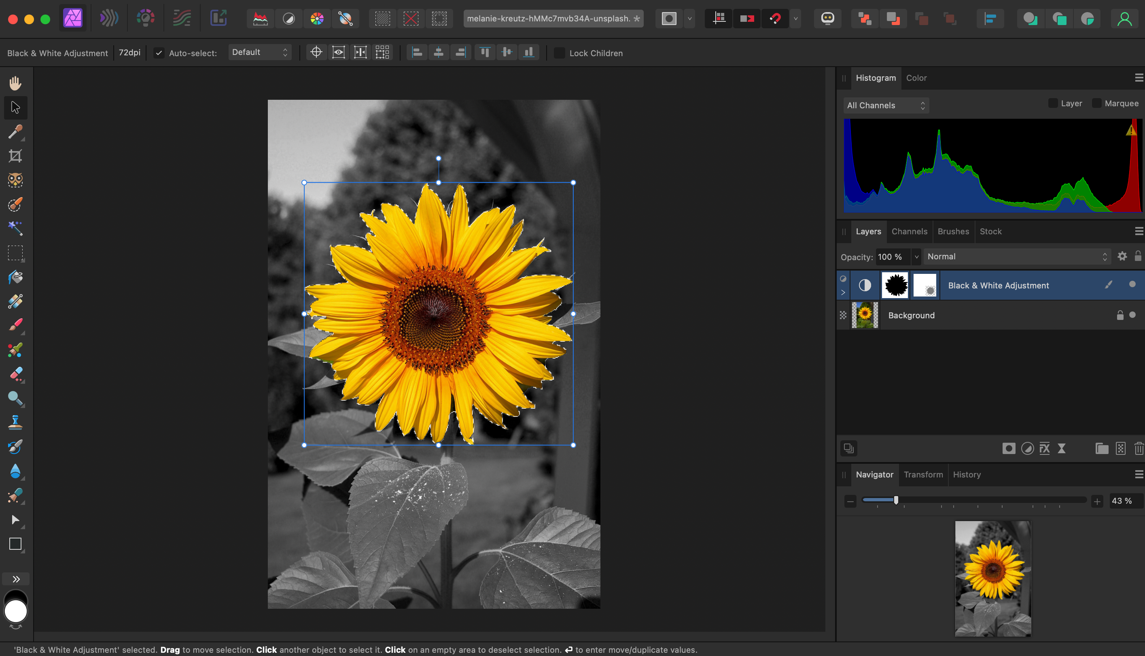
Class Demo: Color Pops

Slide 10
Blending Modes
In class, we learned about alpha blending between two images, which is the default blending mode between layers in programs like photoshop.
With some simple adjustments of the math, blend modes can achieve lots of different effects.

Slide 11
Types of Blending Modes
Normal
Mode | Formula | CV term | Example use case
Normal | (1−α)a + αb | Alpha compositing | Standard blend for green screen, etc.
Darken Group
Mode | Formula | CV term | Example use case
Darken | min(a, b) | Pointwise minimum | Overlaying dark text/logo onto a light photo without masking, white vanish
Multiply | a × b | Pointwise multiplication | Removing a white background from a scanned signature
Color Burn | 1 − (1−a)/b | Inverse division | Punchy, saturated shadow/vignette effect
Linear Burn | a + b − 1 | Additive subtraction | Gritty compositing (paper/dirt overlays)

Slide 12
Types of Blending Modes
Lighten Group
Mode | Formula | CV term | Example use case
Lighten | max(a, b) | Pointwise maximum | Keep the brightest pixel across stacked exposures (e.g. Star-trail astrophotography )
Screen | 1 − (1−a)(1−b) | Multiply's inverse | Adding light leaks, lens flares, or glow effects
Color Dodge | a / (1−b) | Inverse division | Photo-to-pencil-sketch trick (invert + blur a duplicate layer)
Linear Dodge (Add) | a + b, clamped | Pointwise addition | Compositing sparks or fireworks onto a night photo

Slide 13
Types of Blending Modes
Comparative Group
Mode | Formula | CV term | Example use case
Difference | |a − b| | Absolute difference | Checking image registration/alignment (i.e. a perfect match goes solid black)
Exclusion | a + b − 2ab | Softened difference | Lower-contrast stylized color-inversion effects
Subtract | a − b, clamped | Pointwise subtraction | Background subtraction to isolate a moving foreground, or removing dark-frame sensor noise
Divide | a / b, clamped | Pointwise division | Flat-field correction to divide out uneven illumination/vignetting

Slide 14
Types of Blending Modes
Component (HSL) Group
Mode | Formula | CV term | Example use case
Hue | Hue from blend | Channel substitution | Recoloring an object (e.g. car paint) while preserving its shading
Saturation | Saturation from blend | Channel substitution | Selectively boosting/killing saturation in a masked region (e.g. color pops)
Color | Hue + saturation from blend, luminosity from base | Channel substitution | Hand-tinting/colorizing a black-and-white photo
Luminosity | Luminosity from blend, hue + saturation from base | Channel substitution | Applying a brightness map without shifting the underlying colors (advanced dodge-and-burn)

Slide 15
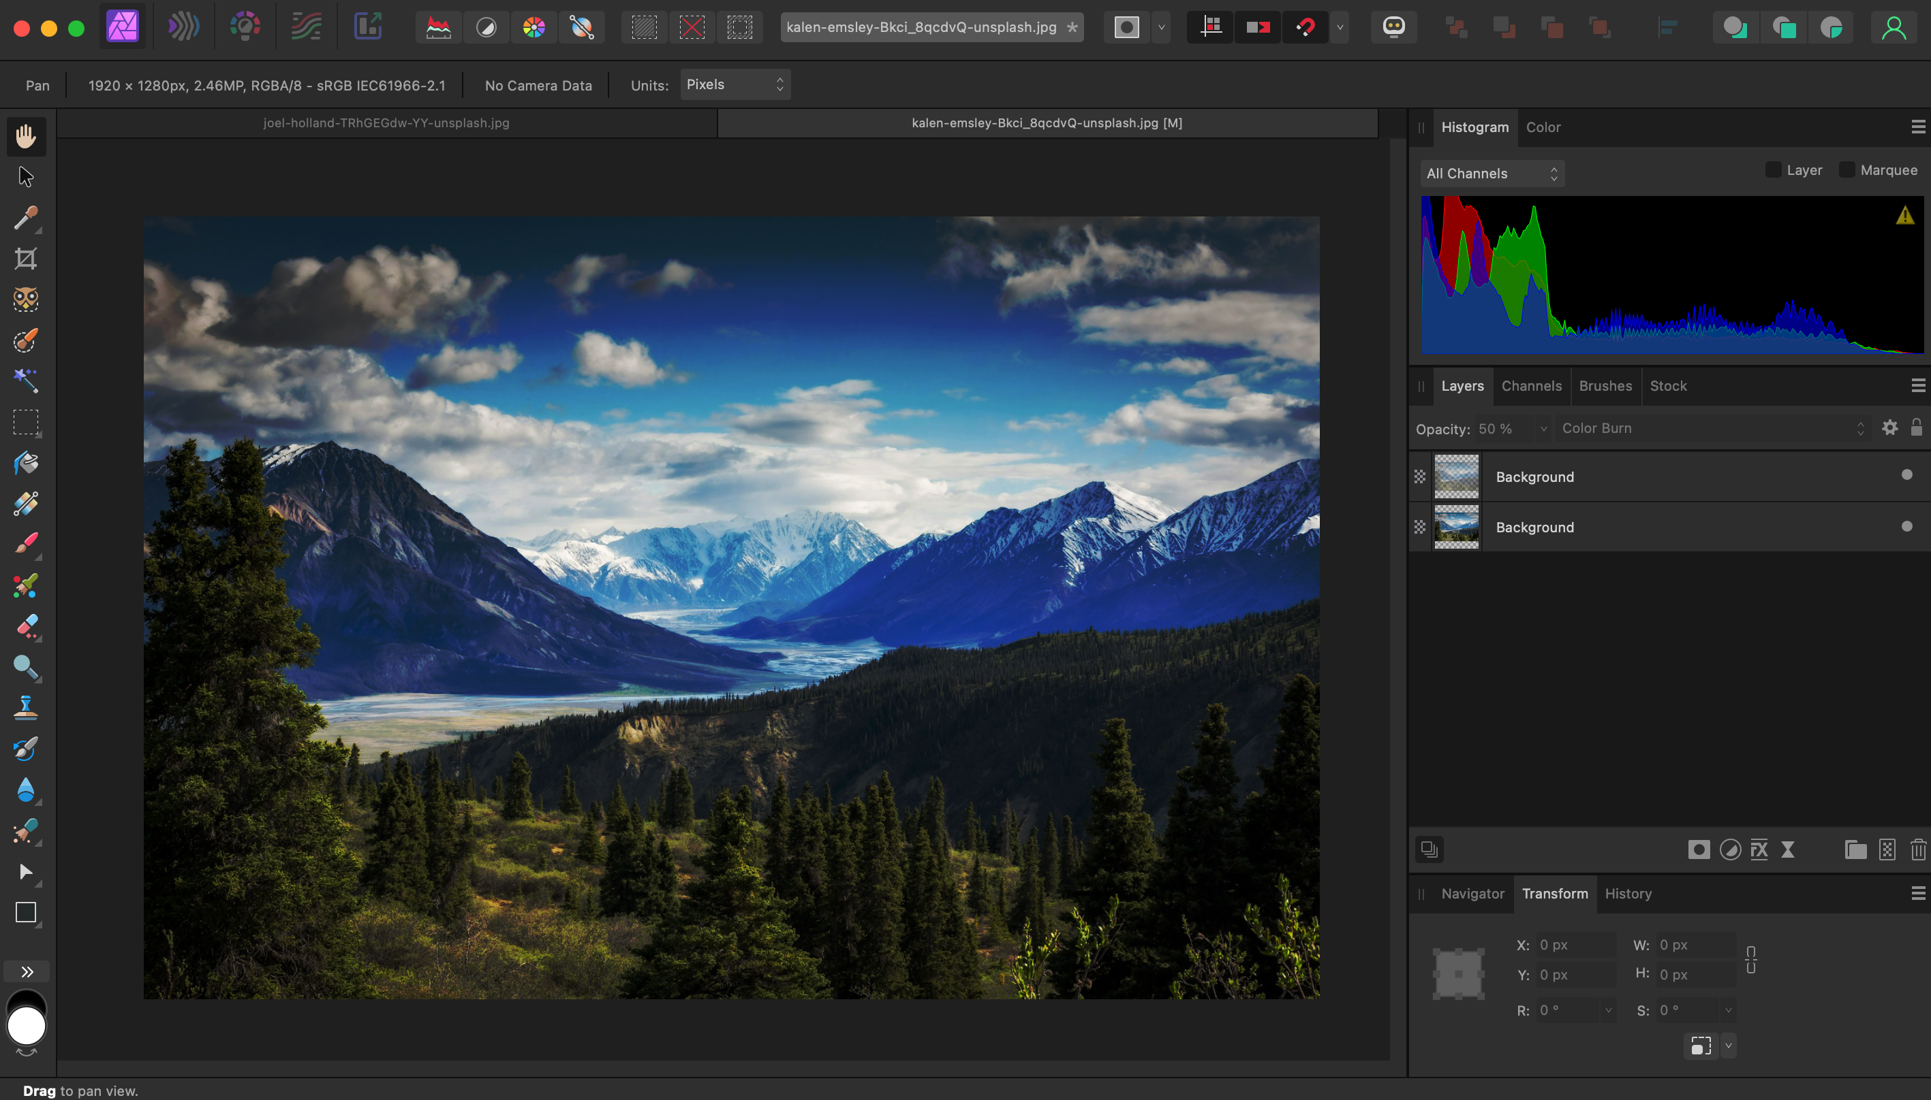
Class Demo: Orton Effect

Slide 16
Saving Edits and Flattening
Why are photoshop files (.psd) bigger than the original image?
  Because they are storing image + operation graph + layer stack + associated parameters
Thus, most programs will have an explicit step where the image is Flattened before being exported to the final bitmap representation (e.g. .jpg, .png, .tif, etc.)

Slide 17
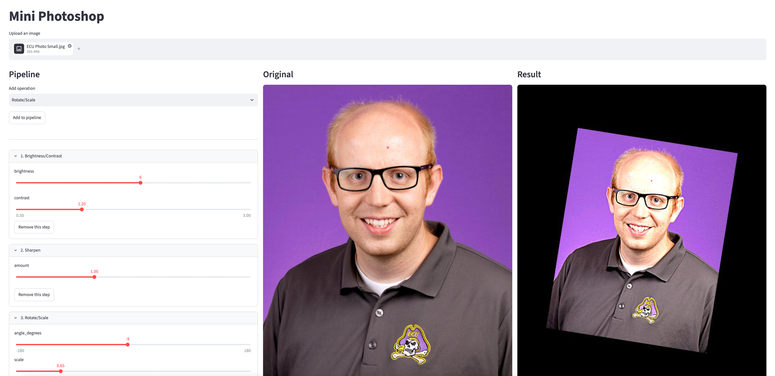
Mini-Lab: My Mini Photoshop

Slide 18
Relying on Image Processing
All the techniques we will learn for the rest of this class will rely on the image processing techniques we have learned previously.
We will continue to use NumPy arrays, dot products, convolution, and transformations.
But rather than relying on our old lab code…

Slide 19
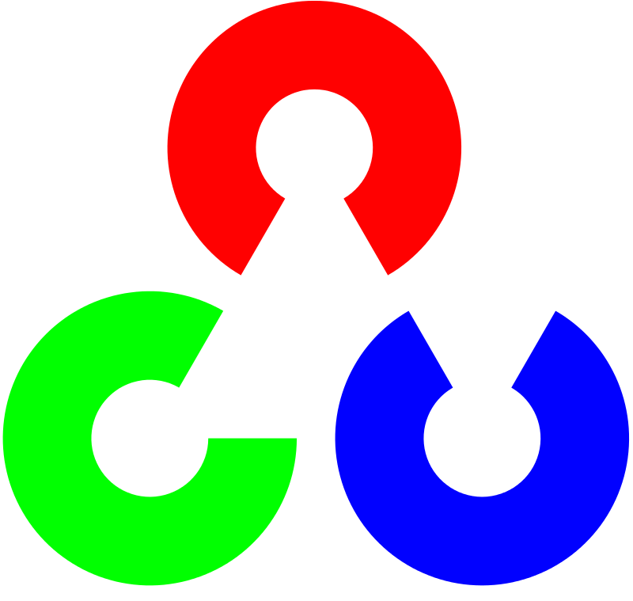
OpenCV
Implements convolution and other image processing techniques we will need (and a lot more!).
Implemented for Python, C++, Java, and other languages.
Watch out for BGR instead of RGB!

Slide 20
Let’s Try It!

Slide 21
Getting Started
Make sure to run “pip install opencv-python” in your environment
import cv2
bird = cv2.imread("test.png")
#BGR vs RGB
plt.imshow(bird[:,:,::-1])
plt.show()

Slide 22
Example: Color Conversion
# Color Conversion
bird_rgb = cv2.cvtColor(bird,cv2.COLOR_BGR2RGB)
bird_gray = cv2.cvtColor(bird,cv2.COLOR_BGR2GRAY)
bird_hsv = cv2.cvtColor(bird,cv2.COLOR_BGR2HSV)

Slide 23
Example: Convolution
# Convolution
kernel=np.array([[1,1,1],
[1,1,1],
[1,1,1]])/9
bird_blur = cv2.filter2D(bird,ddepth=-1,kernel=kernel)
# Alternative
bird_blur = cv2.blur(bird,ksize=(5,5))

Slide 24
Example: Canny Edge Detector
Canny Edge Detector builds on the Sobel kernel to improve the results. It is the standard for most vision tasks.
# Edge Detection
bird_edges = cv2.Canny(bird,20,240)
# 20 = low value threshold, 240 = high value threshold
# You can change these values to improve results

Slide 25
Example: Resizing and Interpolation
# Scaling
bird_big = cv2.resize(bird,(400,400),interpolation=cv2.INTER_LINEAR)
# Resize to 400 x 400 pixels using bilinear interpolation
bird_big = cv2.resize(bird,(400,400),interpolation=cv2.INTER_CUBIC)
# Resize to 400 x 400 pixels using bicubic interpolation

Slide 26
Example: Transformations
# Rotation
M = cv2.getRotationMatrix2D((72,72),90,1)
bird_rot = cv2.warpAffine(bird,M,(144,144))
# Rotates the bird by 90 degrees about the point (72,72)
# Perspective Warp
pts1 = np.float32([[56,65],[100,52],[28,100],[120,140]])
pts2 = np.float32([[0,0],[144,0],[0,144],[144,144]])
M = cv2.getPerspectiveTransform(pts1,pts2)
bird_per = cv2.warpPerspective(bird,M,(144,144))

Slide 27
Things you can do in OpenCV that are hard to do with Matplotlib
Annotation of images (text, bounding boxes)
User interaction (mouse clicks, keyboard, trackbars)
Work with videos

